Slide 1


FinSights
Name: Arnab Chakraborty's
Course: Prompt Engineering- leverages SEC filings data to inform trading strategies.
Date: July 15, 2024

Slide 2
Introduction
Project Focus: Developing an application to analyze SEC filings This project aims to create a tool that processes SEC filings, which are public documents filed by companies to provide a transparent view of their financial performance.
Objective: Inform trading strategies The application will help traders and analysts to extract meaningful insights from these filings, thereby aiding in the creation of data-driven trading strategies.

Slide 3
Project Overview
Objectives
Relevance
Scope
Leverage SEC filings data using RAG to generate trading insights. Improve data retrieval accuracy and enhance insight quality.
Demonstrates practical application of course techniques. Provides efficient analysis tool for financial professionals.
Analyze SEC filings including 10-Ks, 10-Qs, and earnings transcripts. Implement RAG pipeline with function calling.

Slide 4
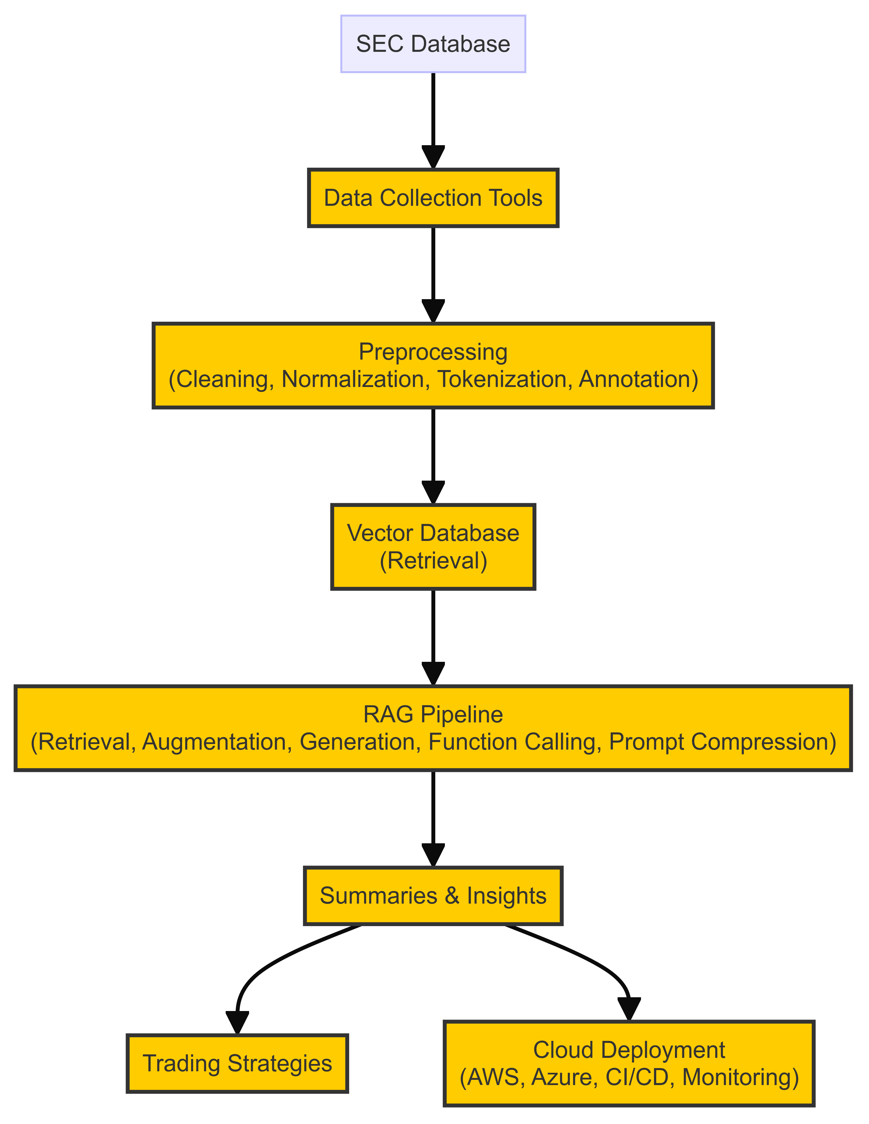




Project Architecture
Data Collection
Gather SEC filings from public sources.
Preprocessing
Clean and structure data for analysis.
RAG Pipeline
Integrate retrieval with language models.
Output
Generate insights and trading strategies.

Slide 5
Data Collection and Preprocessing
1. Source
2. Collection
3. Preprocessing
SEC's EDGAR database, containing regulatory documents.
Use web scraping tools and APIs to gather filings.
Clean, normalize, tokenize, and annotate data for analysis.

Slide 6

RAG Pipeline Implementation
1
Retrieval
Use vector databases to search and retrieve relevant SEC filing sections.
2
Augmentation
Integrate external knowledge sources to enrich context for analysis.
3
Generation
Employ language models to summarize and generate insights from retrieved data.
4
Function Calling
Extract specific financial metrics and details from filings.

Slide 7
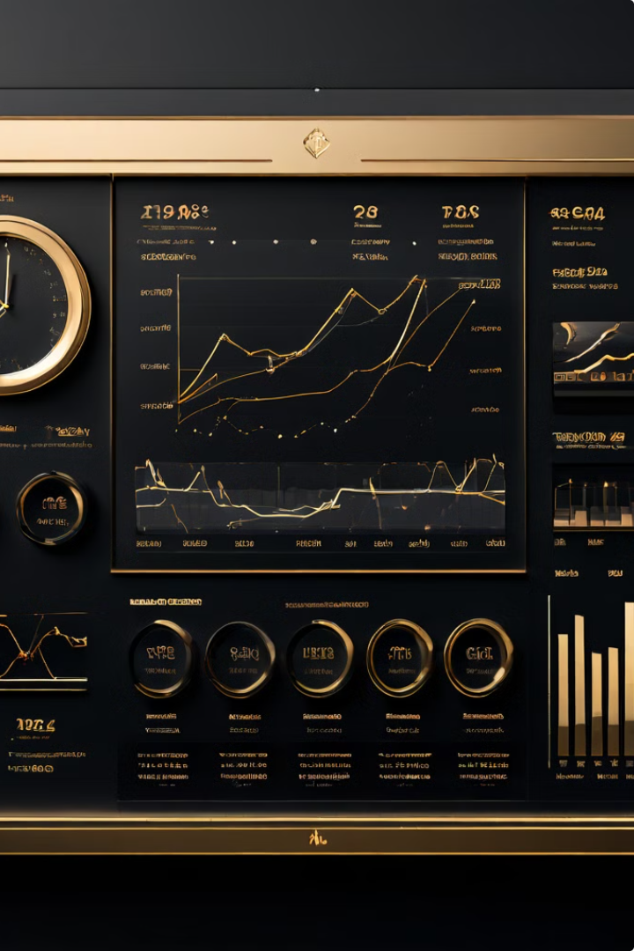
Performance Metrics
Metric
Method
Accuracy
Compare with manually curated summaries
Latency
Measure processing time
Relevance
Conduct user surveys and feedback sessions

Slide 8




Improvement Strategies
Data Augmentation
Model Tuning
Algorithm Optimization
Enrich training data with additional financial documents.
Fine-tune language models for financial text analysis.
Enhance retrieval and generation algorithms for faster processing.

Slide 9

Deployment and Future Work
Deployment Steps
Prepare, test, and deploy the application to a cloud platform.
User Testing
Release beta version and integrate feedback mechanisms.
Future Extensions
Expand to include other financial documents and advanced analytics.

Slide 10


Conclusion
Key Takeaways
Impact
Efficient SEC filing analysis provides advantages in developing trading strategies.
RAG with function calling enhances accuracy and relevance of generated insights.

